Slide 2
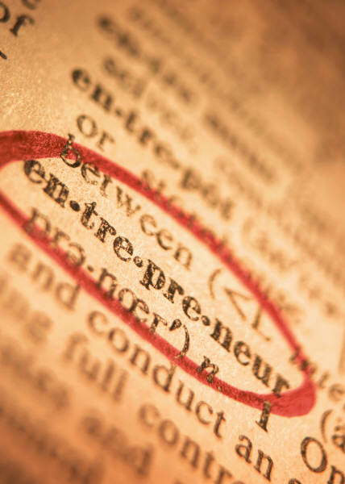
Entrepreneurship

Slide 3
Introduction

Slide 4
Entrepreneurship:
Someone who starts their own Business, Especially when this involves risks.
The Cambridge dictionary

Slide 5
Some thing
New of value
TIME
Efforts
Entrepreneurship

Slide 6
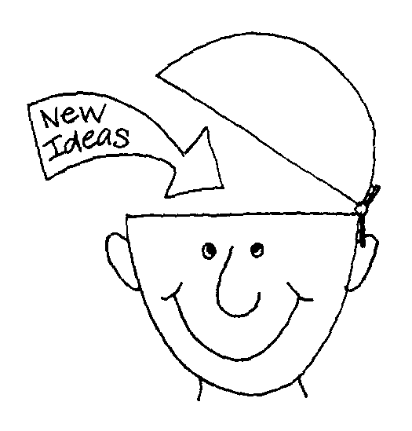
History of Entrepreneurship:
1950
Starting in 1950
New Ideas
Turning in reality

Slide 7
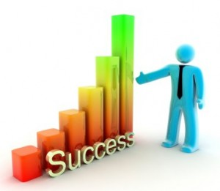
History of Entrepreneurship:
Creation of Internet
Biggest way of Success

Slide 8
Importance of Entrepreneurship
3 Primary Reasons:
Why People
become
Entrepreneurs:

Slide 9
1st Primary Reason is:
Being One's own Boss

Slide 10
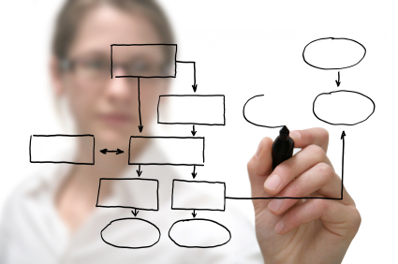
2nd Primary Reason is:
Develop their own ideas

Slide 11
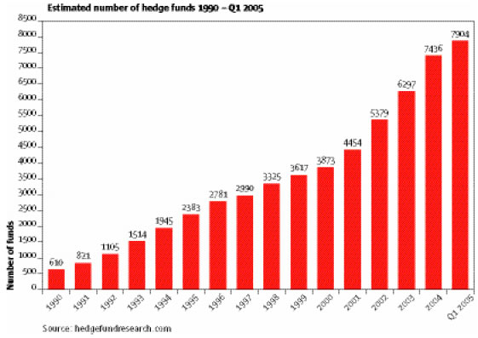
3rd & Final Reason is:
Develop Financial Reward

Slide 12
Evaluation the Importance of Entrepreneurship
Small Businesses in US

Slide 13
Definition
History
Importance
Why people become

Slide 14
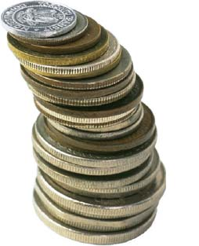
Characteristics & Advantages

Slide 15
Characteristics
Plane Every Thing
Ask for Sale

Slide 16
Characteristics
Grab attention
Limit number of hats

Slide 17
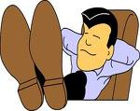
Advantages of entrepreneurship
Provide independence
Complete command

Slide 18
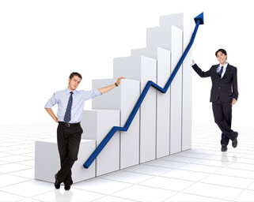
Advantages of entrepreneurship
Provide desired flexibility
Complete command

Slide 19
dis Advantages

Slide 20
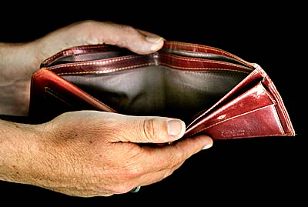
disadvantages
No Regular Salary
Work Schedule

Slide 21
disadvantages
Administration
No experience
Hard to get financing

Slide 22
disadvantages
No Business connections
Less trust
Management problems

Slide 23
disadvantages
Less self-discipline
Less time to live your life

Slide 24
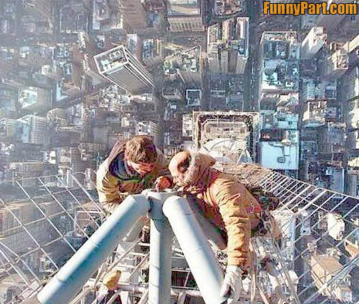
Why entrepreneurship risky

Slide 25
Why entrepreneurship risky
Management Incompetence
Capital Availability
Growth

Slide 26
Why entrepreneurship risky
Inventory Control
Relevant Experience
Marketing

Slide 27
Why entrepreneurship risky
price of Product
Location

Slide 28
Why entrepreneurship risky
Three things are most
important in business:
Location
Location
Location

Slide 29
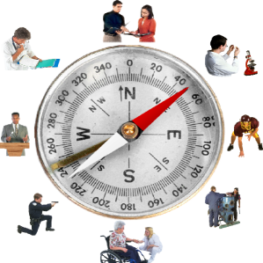
Success & Failure Factors of entrepreneurship

Slide 30
Factors
Initial Strategic plans
Hard Work
Motivation

Slide 31
Factors
Social Skills
Leadership
Good Health

Slide 32
Factors
Luck
Support of Family

Slide 33
Conclusion

