Slide 1
In the name of ALLAH the most beneficent the most merciful

Slide 2
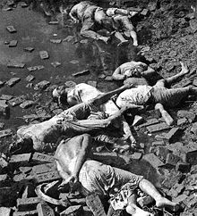
East Pakistan Crisis
In the eye of history
Notes:
In the eye of history

Slide 3
Introduction:
West
East
NWFP
Baluchistan
PUJAB
Kashmir
Sehlet
SINDH
Dhaka
AASAM
Bengal

Slide 4
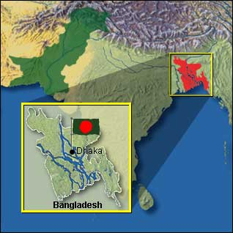
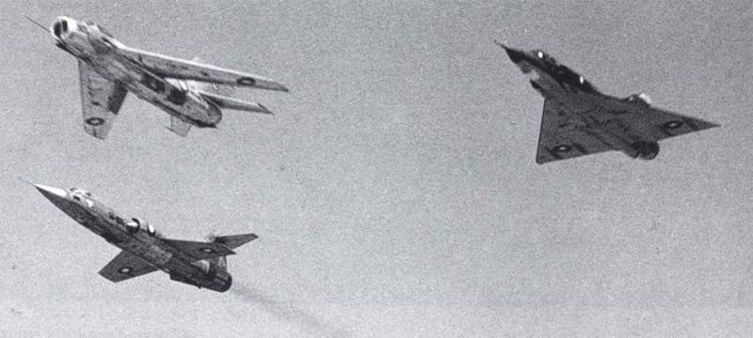

Slide 5
Historical Materialism
Bengal province 1947
Renamed 1956
Population
50.84 Millions

Slide 6
East Pakistan crisis:
Language Problem 1952
1970 Elections.
Awami league.

Slide 7
East Pakistan crisis:
Civil war.
Indo Pak WAR 1971
Separation.

Slide 8
East Pakistan crisis:
Biggest country in Muslim world. 1947
Title was by gone 1971

Slide 9
East Pakistan crisis:
FACTORs
Notes:
FACTORs

Slide 10
East Pakistan crisis:
Disaccord of Geographical Connectedness:

Slide 11
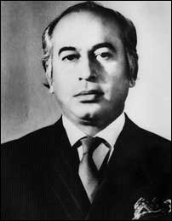
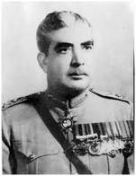
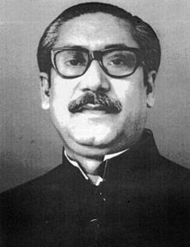
East Pakistan crisis:
Disaccord of leadership:

Slide 12
East Pakistan crisis:
Character of Hindus:
Differences of Languages

Slide 13
East Pakistan crisis:
Education &
Economic Problems:
Constitutional problem:

Slide 14
East Pakistan crisis:
1970 elections:
Six points program:

Slide 15
East Pakistan crisis:
Conclusion
Notes:
FACTORs

Slide 16
East Pakistan crisis:
Lack of Planning
Lack of moral character

Slide 17
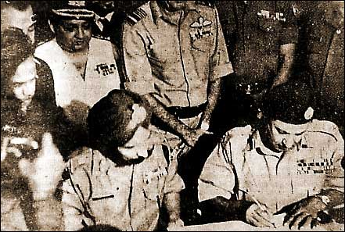
East Pakistan crisis:
Indo-Pak War

Slide 18
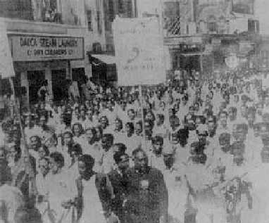
East Pakistan crisis:
Movement
for
independence

Slide 19
East Pakistan crisis:
Pakistan Recognition
For
Bangladesh

Slide 20
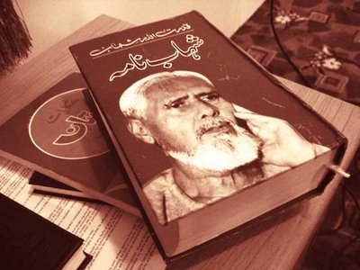
East Pakistan crisis:
End on the
address of
“Qudratullah
Shahab” in
“Shahab Nama”

