Slide 1
Good Evening

Slide 2
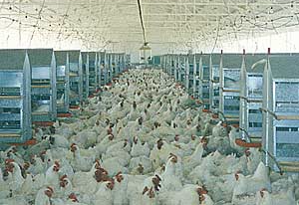
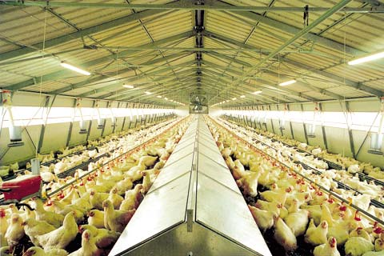
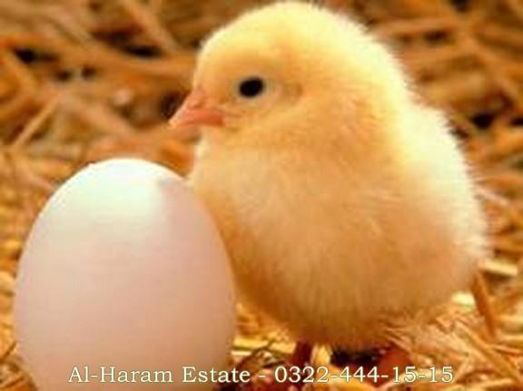
Control Shed
Self-Employed Business

Slide 3
Introduction
Employment of 1.5 Million people:
Period of growing is six week:
Automatically operations:
Start in Ruler & Urban areas:
Consumptions of Poultry meat:

Slide 4
Introduction
Broiler farm with population of 35,000 Birds
Need capital investment of about Rs/= 19.2 Million
Need working capital of about Rs/= 5.7 Million

Slide 5
Introduction
Total Project cost is estimated Rs/= 24.9 Million
Profitable business
- Increasing Demand
- Export Prospect

Slide 6
Current Industry Structure

Slide 7
Current Industry Structure
The generation line
Great Grand Parents
Grand Parents
Parents Stock
Final Product

Slide 8
Current Industry Structure
Poultry meat Production
- Growing trend
- Imposed on wedding dinner
The meat production trend of chicken meat, beef and mutton from the year 2006 to 2010:

Slide 9
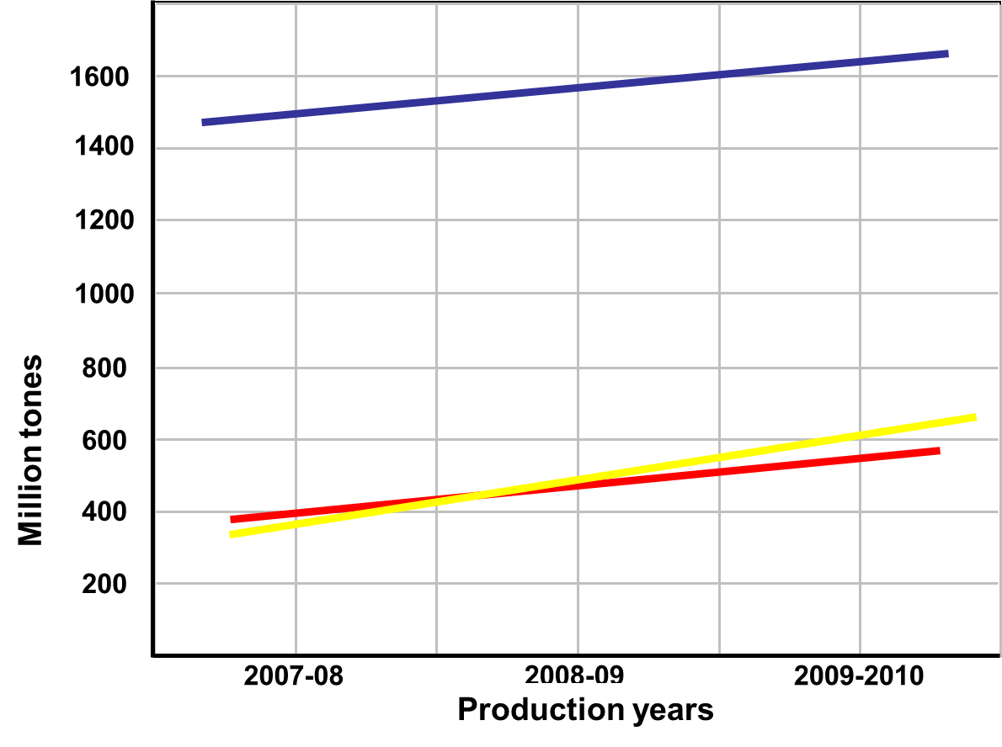
Current Industry Structure

Slide 10
Marketing

Slide 11
Marketing
Follows traditional channels of distribution:
- Middle man and Wholesaler
- Transportation
- Directly sold to shopkeeper
Chief minister Shahbaz shrif orders about marketing of Broilers

Slide 12
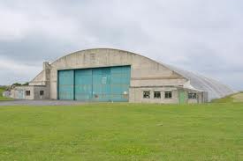
Location of our control shed

Slide 13
Our Business locate in outside area of Lahore at
5 km near kahna nau main kasur road Lahore
Location of our control shed

Slide 14
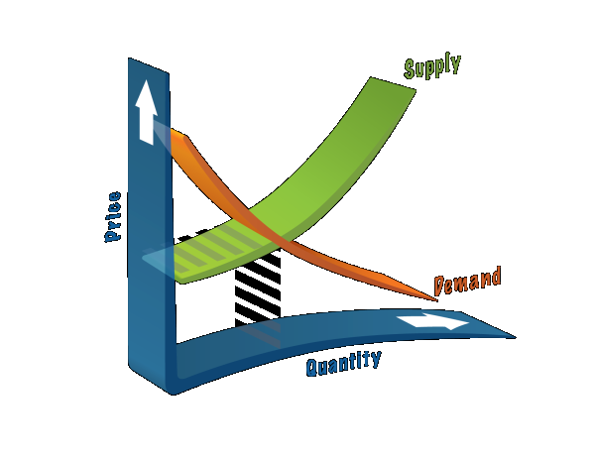
Demand & supply

Slide 15
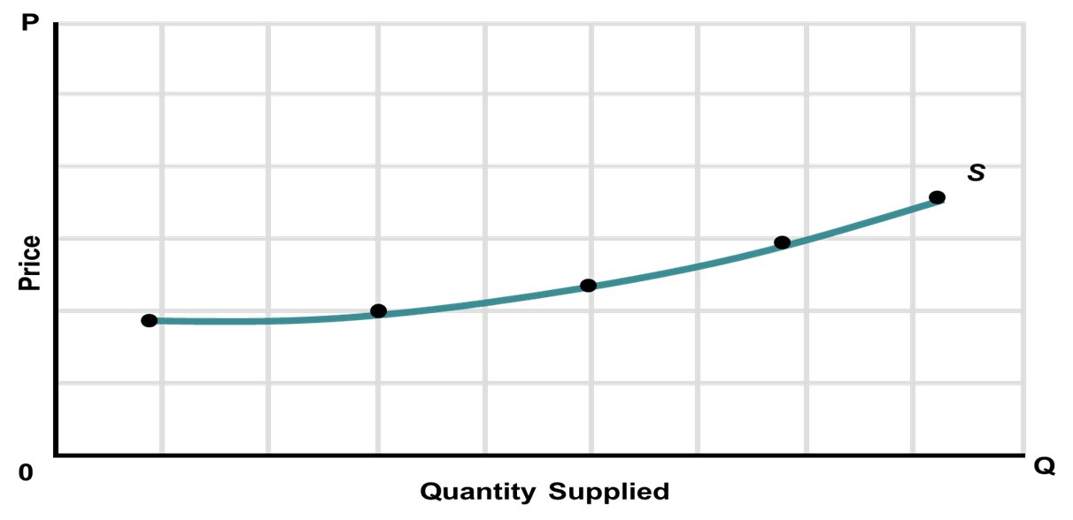
Production of Broiler
Year | Production
2006-07 | 554
2007-08 | 601
2008-09 | 652
2009-10 | 707
2010-11 | 759

Slide 16
Demand of Broiler
The consumption of poultry meat in Pakistan has increased 239% in the last 11 years from 322 million tons in 1999/2000 to 767 million tons in 2010/11.
Levels of preference of chicken and mutton have interchanged between the years 1995 and 2010.

Slide 18
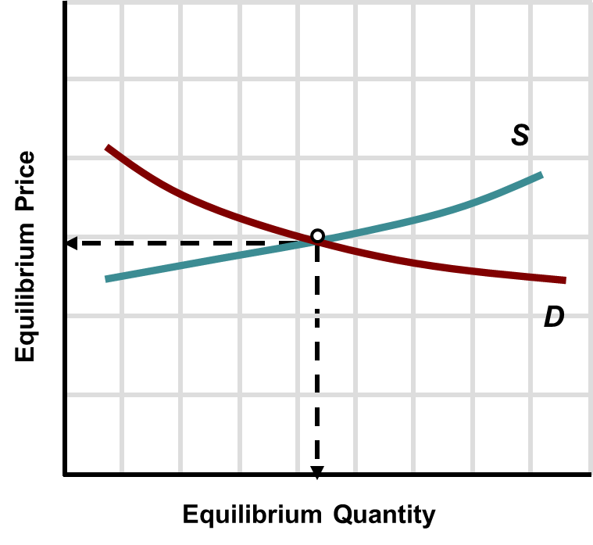
Equilibrium of Broiler
Demand & Supply of Broiler meat is Elastic.

Slide 19
Requirements & Management

Slide 20
Production Assumptions
Product | Avg. Live Weight (kg) | Price per kg
Chicken | 1.85 | Rs. 110
Number of Flocks per year | 6
Number of Birds per Flock | 35,000
Time required per Flock (Days) | 40
Lag time required per Flock (Days) | 15
Total Annual Production Capacity | 210,000
Shed Space Required per Bird (sq. ft.) | 0.65
Sale price growth rate (%) | 10
Production capacity utilization (%) | 100

Slide 21
Manpower Requirement
Description (HR Requirements) | NO | Salary per month | Salary per Year
Supervisor | 1 | 10,000 | 120,000
House man | 2 | 11,000 | 132,000
Electrician | 1 | 7,500 | 90,000
Watch man | 2 | 11,000 | 132,000
Cleaner | 1 | 6,000 | 72,000
Total | 9 | 45,500 | 546,000

Slide 22
Farm Equipment's
Description | Amount
Main Feed Line System | 85,000
Feed Pan System | 524,170
Nipple Drinking System | 337,470
Ventilation System (Cone Fans) | 308,700
Minimum Ventilation Fan | 60,782
Pad Cooling System | 142,296
Minimum Ventilation System | 185,304
Motor for Air Intel | 26,000
Controlling Equipment’s | 45,000
Heating System | 250,000
Total Cost of Machinery | 1,964,722

Slide 23
Land & Building
Land should be
- Purchased
- Along Road side around the city
- Isolated place
- Transportation handled easily
- Availability of Electric connection
- Availability of Quality drink water

Slide 24
Land & Building
Land requirement for Control shed is:
Total Building and infrastructure cost for Control shed
Land | Per Acre Cost | Total Cost Rs.
1.5 Acre | 1,000,000 | 1,500,000

Slide 25
Description | Area (sq.ft.) | Cost (Rs. / sq.ft.) | Total (Rs.)
Shed Space (380ft X 61ft) | 23,180 | 570 | 13,212,600
Building for Resident & Office Purposes Ground Floor
Feed Store | 500
Toilet Block | 100
Admin Office | 100
Areas for Corridor | 150
Generator Set Room | 400
Store for Vaccine & Medicines & Misc. | 150
Changing / Store Room | 100
Rooms for Staff | 400
Kitchen | 80
Total Area | 1980 | 750 | 14,85,000
Boundary wall 7 feet height |  |  | 500,000
Total Building & Infrastructure Cost | 14,697,600

Slide 26
Types of costs

Slide 27
Types of Costs
Costs for a startup business
Administrative Costs:
Administration expense | 546,000
Administration benefits expense | 16,380
Travelling expense | 27,300
Communication expense | 16,380
Office expense (stationary etc…) | 16,380
Professional fees (legal, audit etc.) | 20,726
Depreciation expense | 1,029,639
Amortization of pre-operating costs | 16,000
Subtotal | 1,688,805

Slide 28
Types of Costs
Costs for a startup business
Costs for sales:
Cost of DOC | 12,600,000
Cost of Feed | 18,000,000
Operations costs (direct labor) | 300,000
Vaccination, Medication & Disinfection | 1,500,000
Direct Electricity | 2,000,000
Diesel for Generator & Heater | 1,500,000
Litter & Spray Cost | 240,000
Total cost of sales | 36,140,000

Slide 29
Types of Costs
Costs for a startup business
Fixed Costs:
Administration expense | 546,000
Administration benefits expense | 16,380
Travelling expense | 27,300
Communication expense | 16,380
Office expense (stationary etc…) | 16,380
Professional fees (legal, audit etc.) | 20,726
Depreciation expense | 1,029,639
Amortization of pre-operating costs | 16,000
Subtotal | 1,688,805

Slide 30
Types of Costs
Costs for a startup business
Variable Costs:
Cost of DOC | 12,600,000
Cost of Feed | 18,000,000
Operations costs (direct labor) | 300,000
Vaccination, Medication & Disinfection | 1,500,000
Direct Electricity | 2,000,000
Diesel for Generator & Heater | 1,500,000
Litter & Spray Cost | 240,000
Total variable cost | 36,140,000

Slide 31
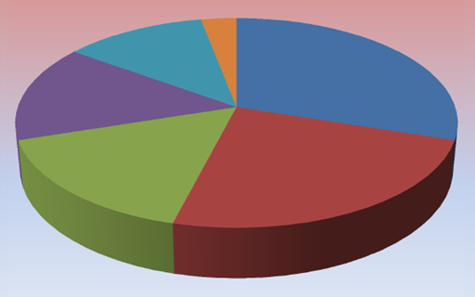
Total Project Cost

Slide 32
Total Capital Investment
Capital Investment | Rs.
Land | 1,500,000
Building/Infrastructure | 14,697,600
Machinery & Equipment | 2,882,591
Furniture & Fixture | 35,000
Office equipment | 30,000
Pre-Operating Costs | 80,000
Total Capital Costs | 19,225,191

Slide 33
T
Total Capital Investment
Working Capital | Rs.
Raw material inventory | 5,200,000
Cash | 500,000
Total Working Capital | 5,700,000
Total Investment | 24,925,191
Notes:
Capi

Slide 34
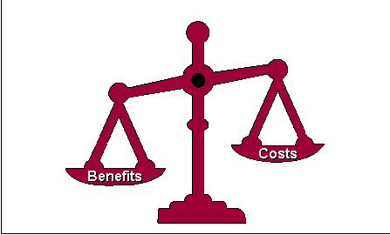
Cost Benefit Analysis

Slide 35
Cost-Benefit Analysis
Total cost on this Project is Rs/= 39,522,341
Total Revenue earn from this business is Rs/= 41,452,950
So,
Total Profit earn from this business per year is Rs/= 1,930,609
Clearly shows that the starting of this business is justified. And the business will save almost Rs/= 1.9 million a year

Slide 36
Income statement Analysis

Slide 37
Income Statement Analysis
Total Revenue | 41,452,950
Total cost of sales | 36,140,000
Gross Profit | 53,12,950
Admin & General Expenses | 1,688,805
Operating Income | 36,24,145

Slide 38
Income Statement Analysis
Interest Expenses on Long term debts | 10,50,000
Tax | 643,536
Net Profit | 19,30,609

Slide 39
Profit OR Loss Analysis

Slide 40
Profit OR Loss Analysis

Slide 41
THE END

