Slide 2
Group Members:
GHULAM HASSAN
YASIR ABBAS
ABDULLAH SAEED

Slide 3
Market Concept Analysis

Slide 4
PRODUCT

Slide 5
Product:
A set of benefits offered for exchange and it can be tangible OR intangible.

Slide 6
Two parallel paths involved :
New Product development:
Idea generation, product design & detail engineering
Market research and marketing analysis.

Slide 7
Launching

Slide 8
NEW
OLD

Slide 9
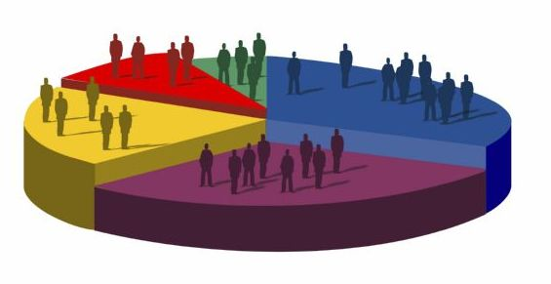
Consumer Behaviour

Slide 10
Consumer behavior:
The study of when, why, how, and where people do or do not buy a product.

Slide 11
Consumer behavior Survey:

Slide 12
Consumer behavior Survey:

Slide 13
Consumer behavior Survey:

Slide 14
Consumer behavior Survey:

Slide 15
Reasons:
High Prices
Low popularity
Not common Availability

Slide 16
Results of using:
Scratch full
Shine less

Slide 17
Available in market:
Rs 850/=
to
Rs 2000/=

Slide 19
Power Max
Free from phosphate
Less expensive
Easy in use
Easily Available

Slide 20
Process

Slide 21
Process of N.P.D:
Idea Generation:

Slide 22
Process of N.P.D:
Idea Screening:

Slide 23
Benefit from the product to customer?
Size of the market segment/target market?
Competitive pressure for the product idea?
industry sales and market trends the product idea is based on?
Is it technically feasible to manufacture the product?

Slide 24
Process of N.P.D:
Product Development
And Testing:

Slide 25
Process of N.P.D:
Business Analysis:

Slide 26
Process of N.P.D:
Selling price based upon competition & customer feedback
Sales volume based upon size of market
Profitability and break-even point

Slide 27
Process of N.P.D:
Commercialization:

Slide 28
Process of N.P.D:
Launch the product
Advertisements and other promotions
Critical path analysis is most useful at this stage

Slide 29
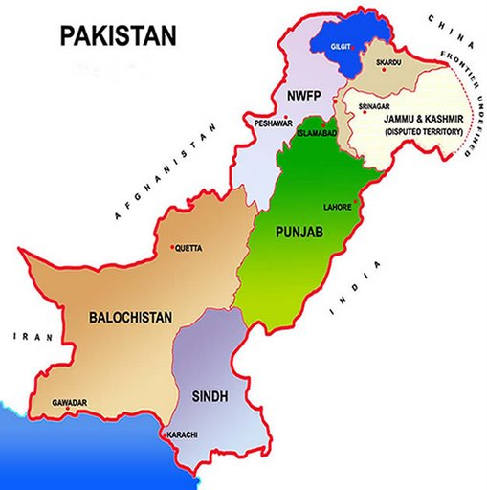
Geograph ical area

Slide 30
Attractiveness:
Size of the segment
Growth rate of the segment
Competition in the segment
Required market share to break even
Sales potential
Expected profit margins

Slide 31
Suitability:
Superior value to the customers
The impact of serving
Access to distribution channels
The firm's resources vs. capital investment

Slide 32
Identification

Slide 33
Basis for Segmentation:
Geographic
Demographic
Psychographic
Behavioralistic

Slide 34
Geographic:
Region:
Size of metropolitan area:
Population density:
Climate:

Slide 35
Demographic:
Age | Gender
Family size | Income
Occupation | Education
Generation | Nationality
Religion | Social class

Slide 36
Psychographic:
Activities:
Interest:
opinions:
attitude:
values:

Slide 37
Behavioralistic:
Benefits sought
Usage rate
Brand loyalty
User status:
Readiness to buy
Occasions

Slide 38
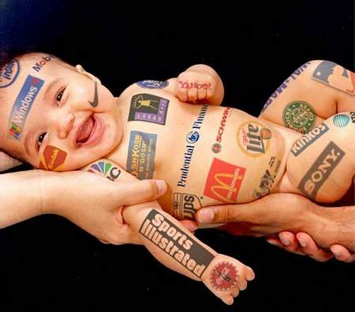
Market Mix

Slide 39
Marketing Mix:
Product
Price
Place (distribution)
Promotion

Slide 40
Product:
Brand name Functionality Styling Quality Safety | Packaging Repairs Warranty Accessories Services

Slide 41
Price:
Pricing strategy Suggested retail price Volume discounts Wholesale pricing Cash and early payment discounts | Seasonal pricing Bundling Price flexibility Price discrimination

Slide 42
Placement:
Distribution channels Market coverage Specific channel members Inventory management | Warehousing Distribution centers Order processing Transportation Reverse logistics

Slide 43
Promotion:
Promotional strategy
Advertising
Personal selling & sales force
Sales promotions
Public relations & publicity
Marketing communications budget

Slide 44
BCG Matrix

Slide 46
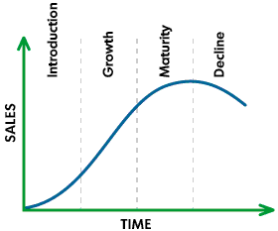
Product Life Cycle

Slide 47
Profitability Analysis

Slide 48
Profit = Revenue – cost
Estimated and Actual Production = 1000 units of 250ml and 500 units of 125ml
Sales = 900 units of 250ml and 400 units of 125ml
Price Rs 165/= 250ml & Rs 95/= 125ml per unit
Beginning finished goods 0

Slide 49
Profitibility:
Sales 252,500
Cost of goods sold 184,500
Gross profit 68,000
Less expenses 44,000
Operating Income 44,000

